Slide 1
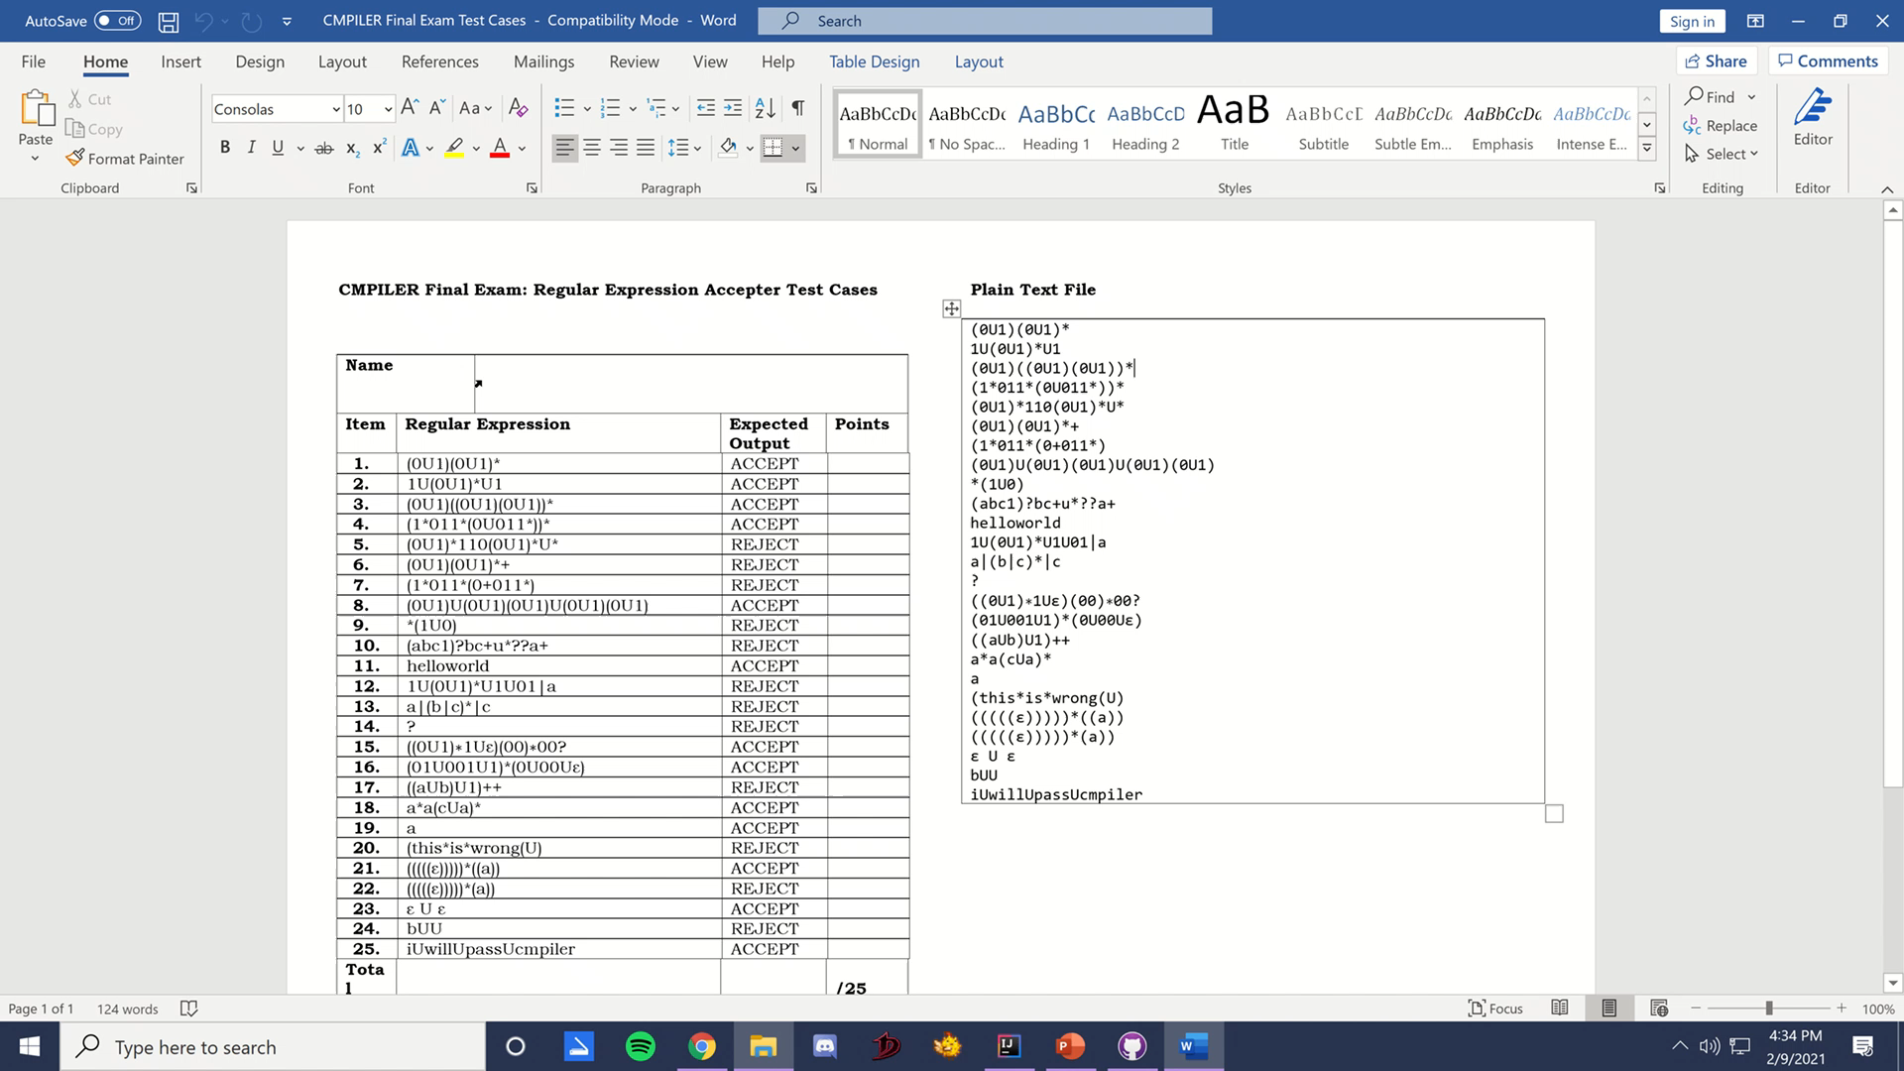
Final Exam: Regular Expression Recognizer
Submitted by: Dyonne Maxime D. Macalino | CMPILER S12

Slide 2
Lexical Analysis
Discussion of lexical analyzer implementation. Discuss token implementation.

Slide 3
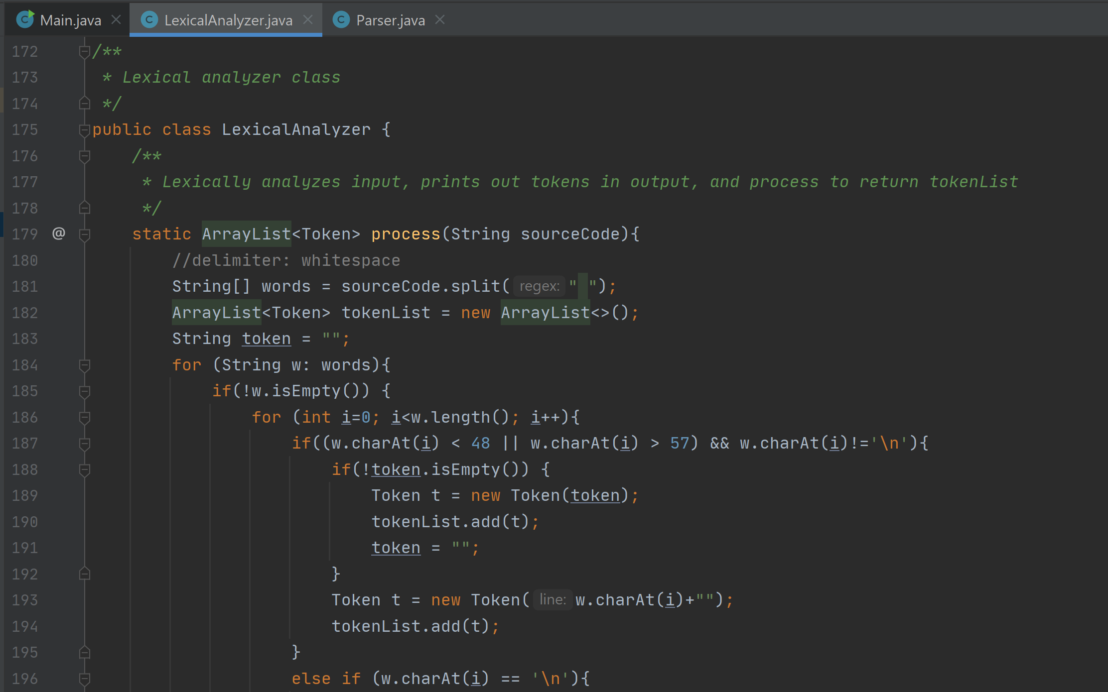
Code Snippet: Lexical Analyzer class

Slide 4
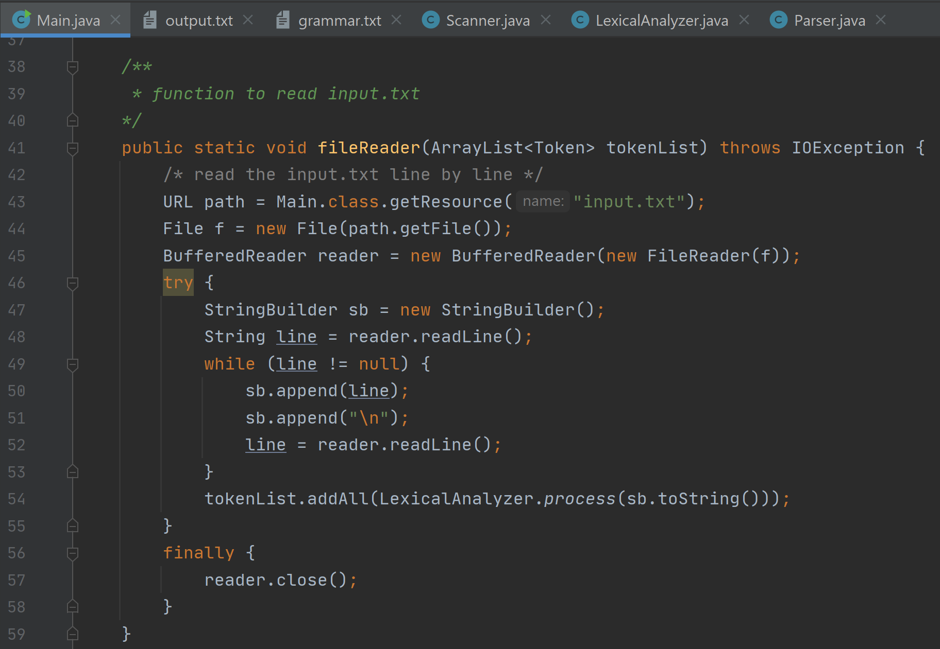
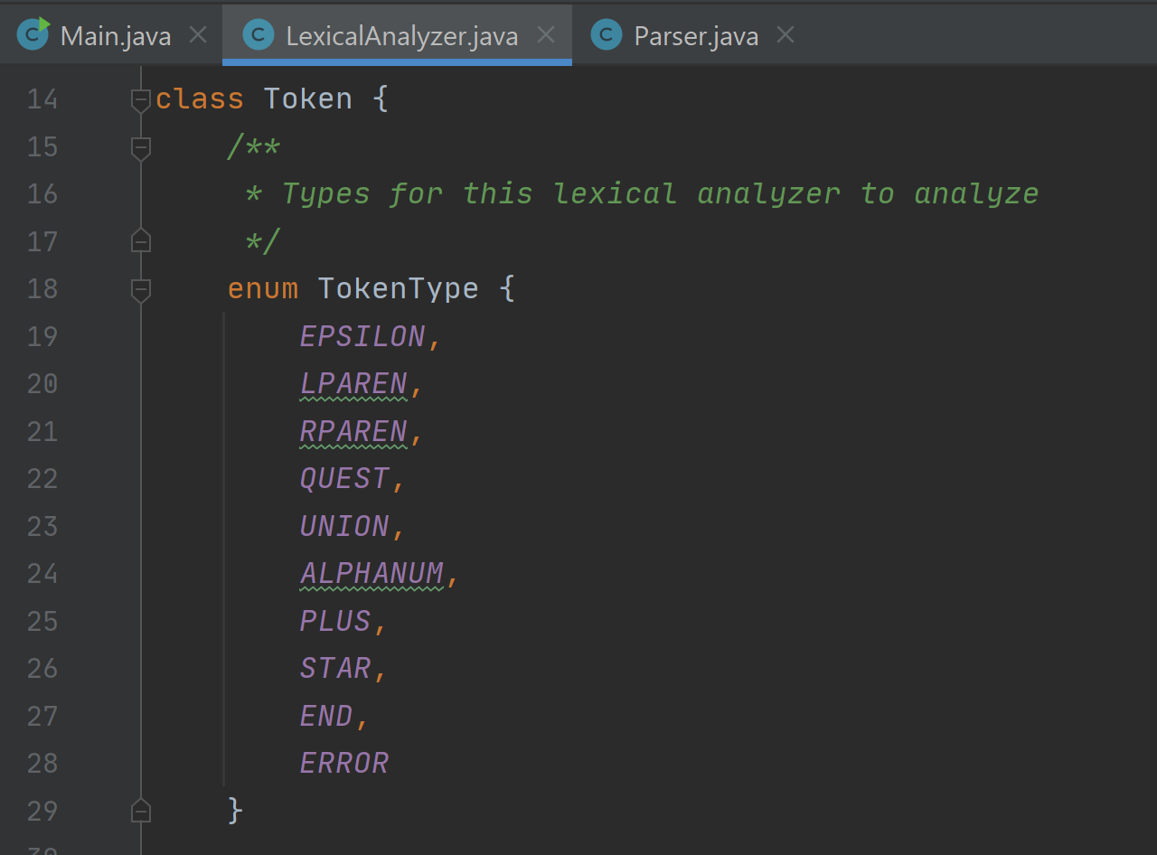
Reading Text Input and Create Tokens
The text input is read through a fileReader function called in main that initially takes in an empty ArrayList<Token> tokenList.
The function makes use of the BufferedReader class to read the “input.txt” provided, and after reading line by line, creates token classes for each number, symbol, or invalid token (these are the terminal symbols), and adds it to the tokenList.

Slide 5
Syntax Analysis
Discussion of syntax analyzer implementation. Show your grammar rules.

Slide 6
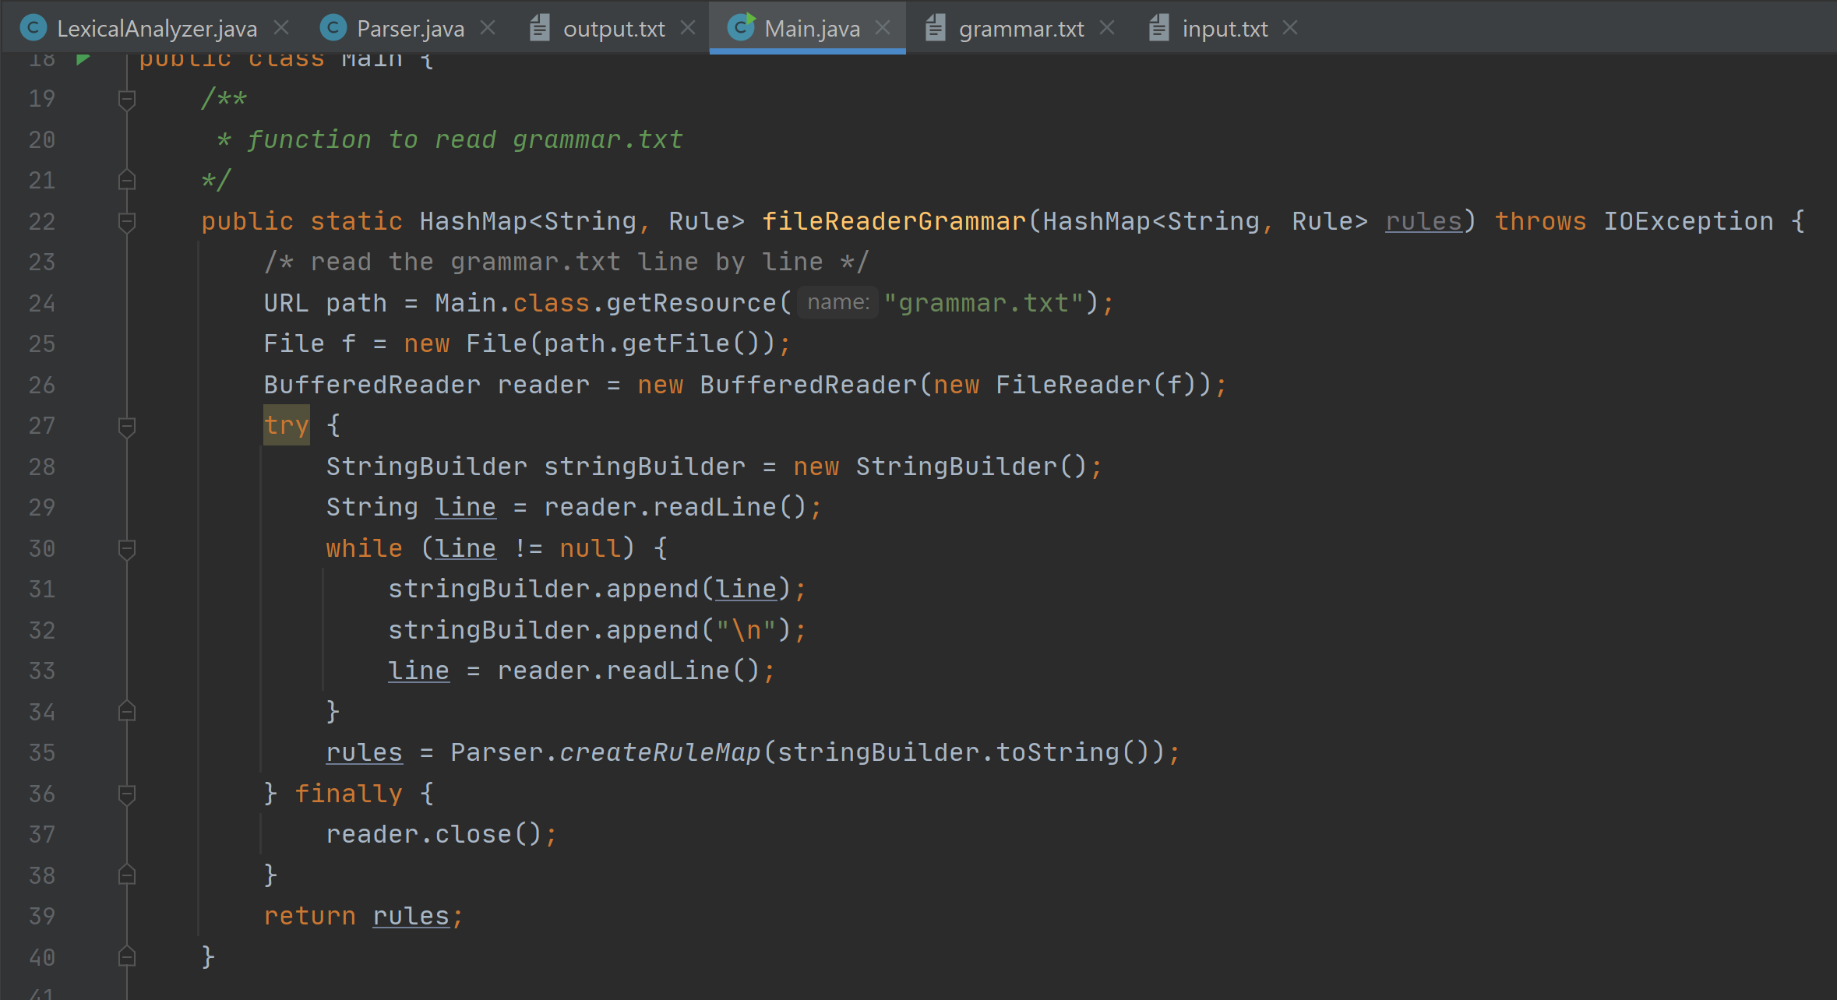
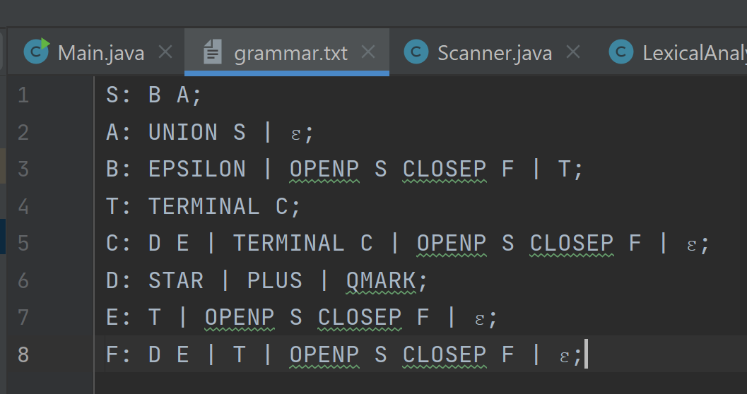
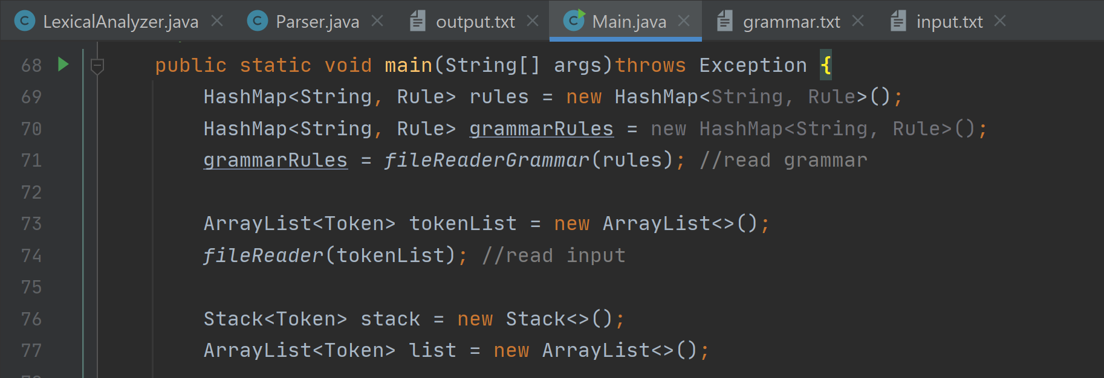
Reading Grammar File and Create Grammar Rules
The grammar rules are made through a fileReaderGrammar function called in main that reads the “grammar.txt” file containing the grammar rules that are separated by ":" respectively.
The function makes use of the BufferedReader class to read the “grammar.txt” provided, and after reading line by line, creates the grammar rules which will be saved in a HashMap.

Slide 7
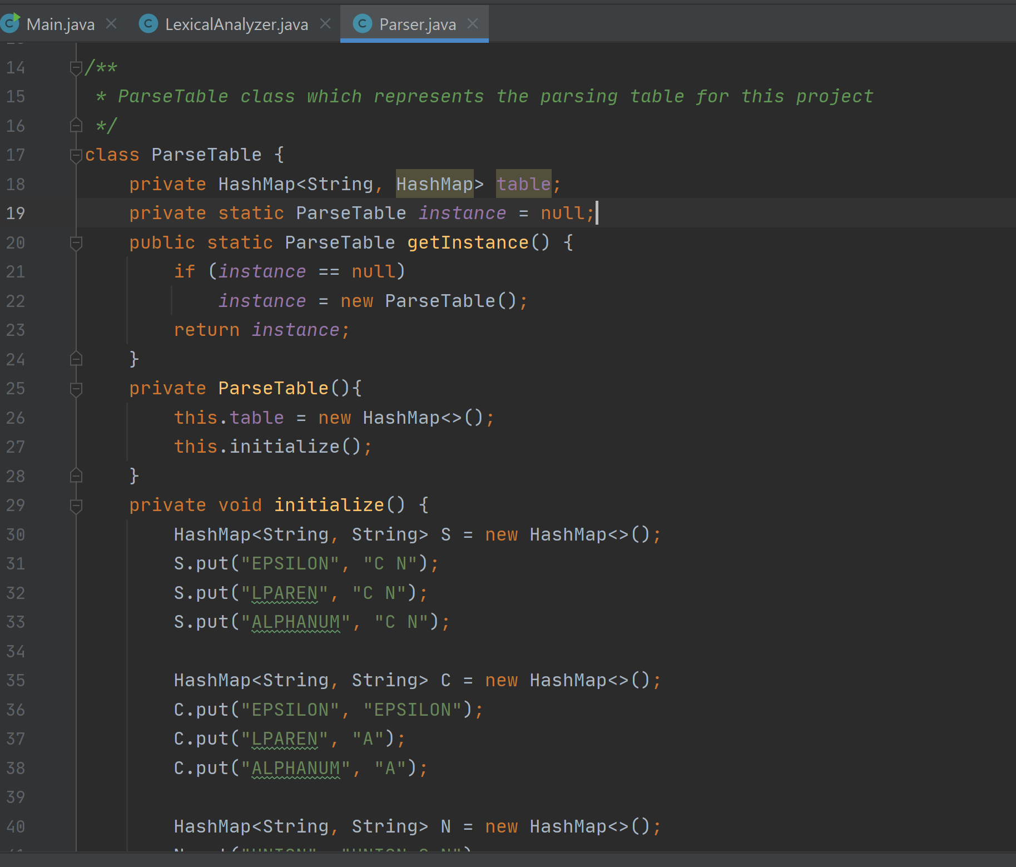
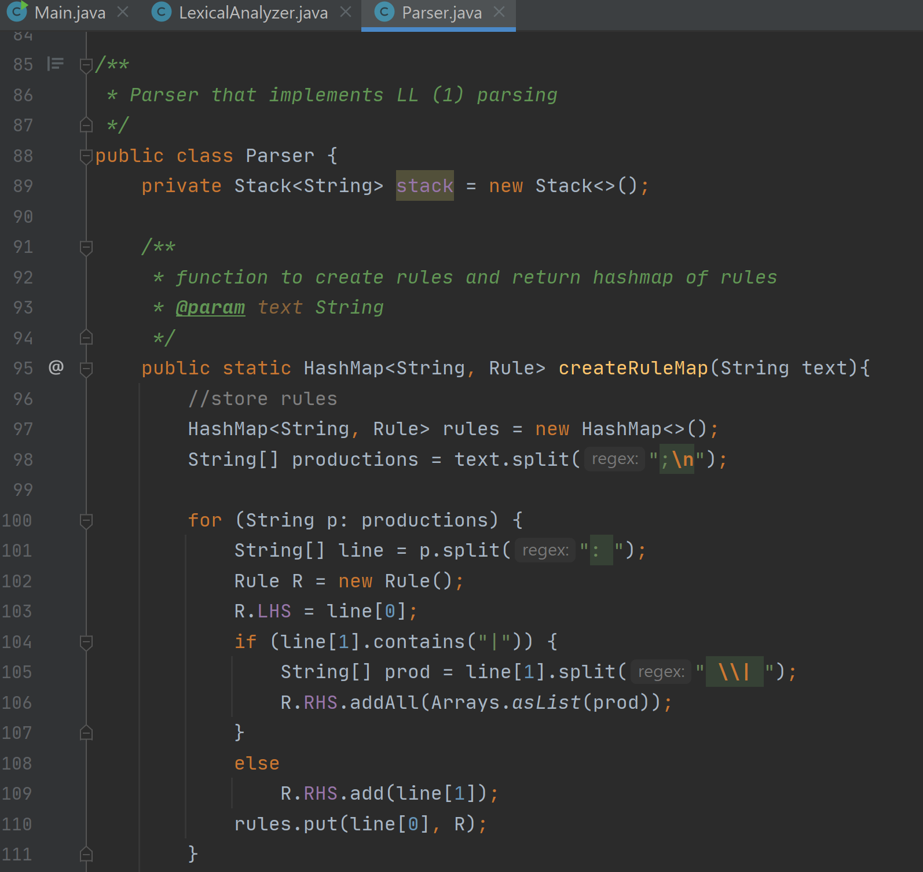
Parse Table and Parsing
The syntax analyzer for this project implements LL(1) Parsing which is the Parser.java class
The parse table class creates the parsing table. The values are filled by using the first and follow sets. The corresponding production is also matched to its proper terminal column.
It follows the grammar rules specified in the “grammar.txt” mentioned in the previous slide.
If the program detects the input as invalid, it is REJECTED. If it is valid, it is ACCEPTED.

Slide 8

Thank
you!
Github repository:
https://github.com/dyonne-mio/ll1-parser

